Slide 1
Health Insurance Claim Management System
IST 659 – Data base management Systems
Pan Chen
November 28, 2016

Slide 2
Project Goals
The major data questions :
What’s the status of one particular insurance claim? Is it paid in full? If not, how much is owed by the patient?
Is the bill from one particular patient being paid? If not, how much does the patient owe the clinic?
How many claims is each of the staff member handling? How many is settled?

Slide 3
Project Goals
Major functions of database systems are :
What data to collect
Patients’ personal information
Patients’ insurance policies information
Staff Members’ personal information
Patients’ office visits information
The claims(s) associated with the office visits
The detailed information regarding every single claim

Slide 4
Project Goals
Who can Input the data
The practitioner
The staff members
Who can query the data
The practitioner
The staff members

Slide 5
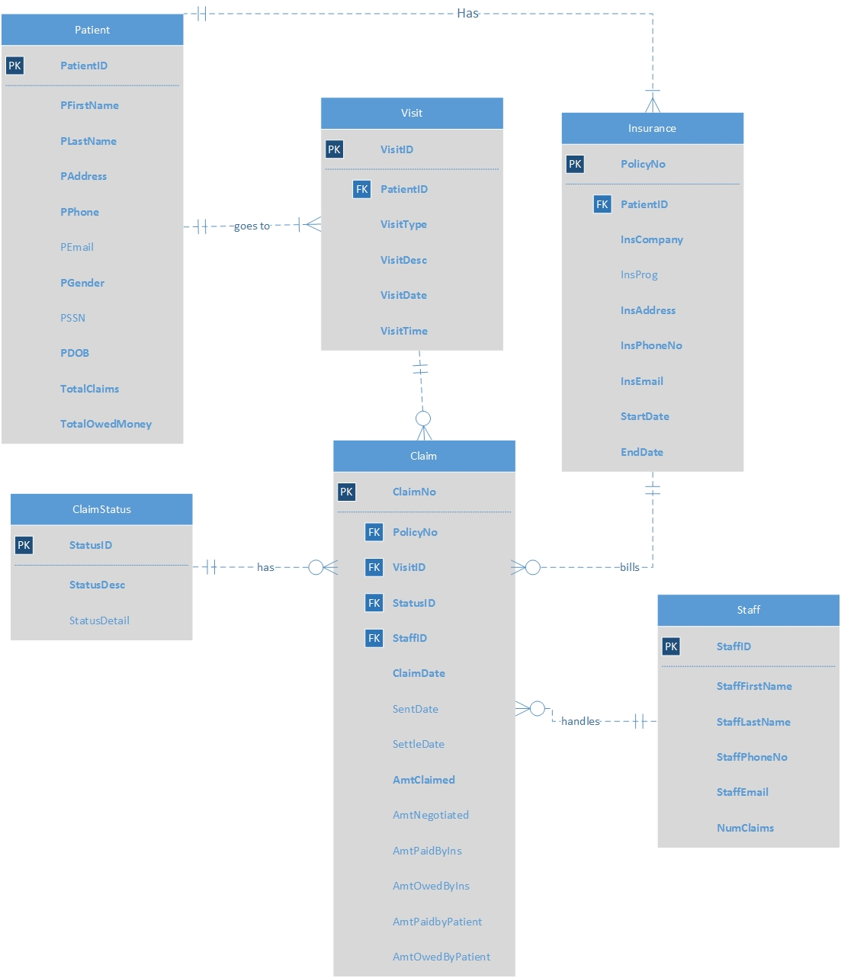
ER Diagram - Visio

Slide 6
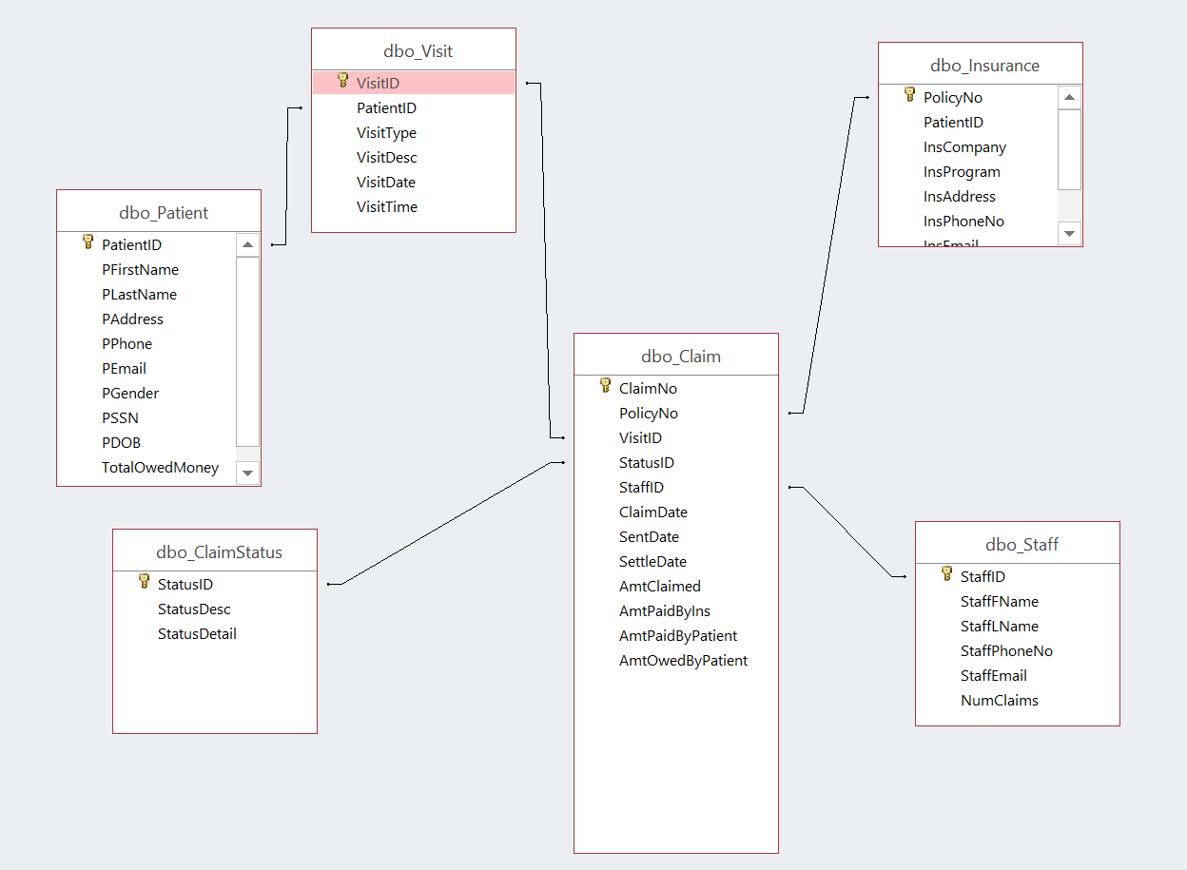
ER Diagram – Access Relationship Diagram

Slide 7
Forms
Total Number of Tables : 6
Total Number of Forms : 6
Patient Information Input(allows you to add and view patients’ personal information)
Office Visit Input(allows you to add and view the detail of different clinic visits)
Insurance Policies (allows you to add and view insurance policies of different patients)
Staff Member(allows you to view and edit information of each staff member)
Claim(allows you to view and edit the information of different claims)
Claim Status(allows you to view and edit the status and the detail of a particular claim)
Patient and Claim (allow you to view each patient’s claims quickly)

Slide 8
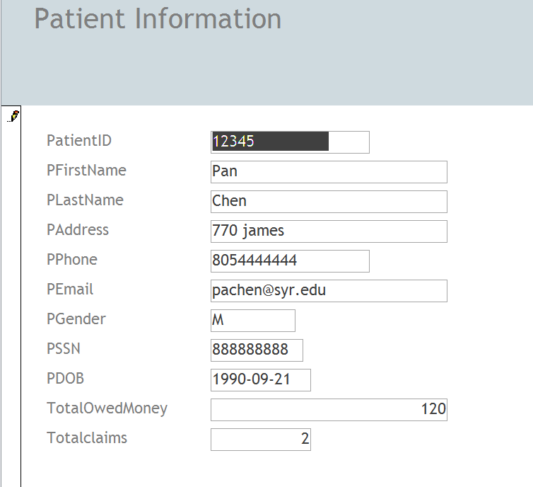
Forms – Patient Information

Slide 9
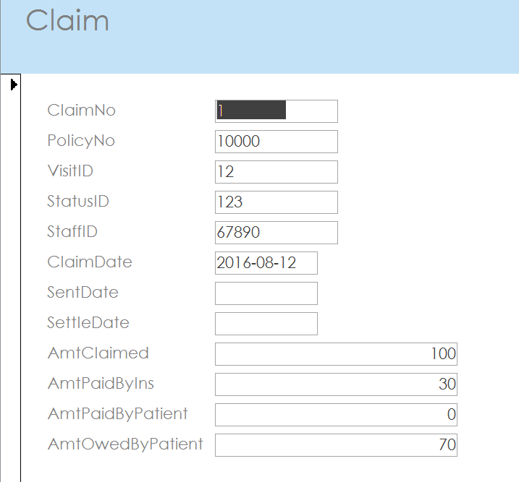
Forms
Claim Information input

Slide 10
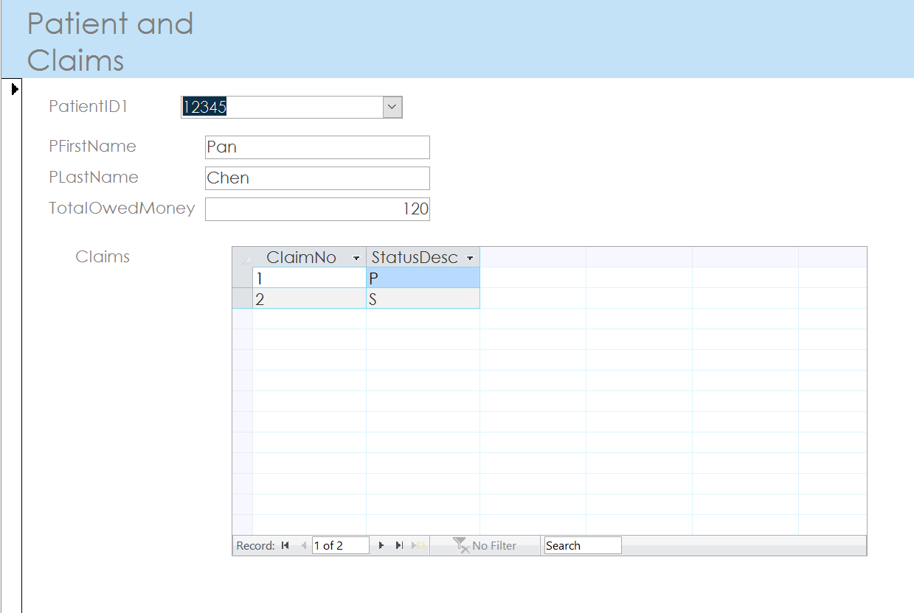
Forms
Check each patient’s claim quickly

Slide 11
Major Data Questions- Reports
How many claims are associated with each patient? What are they?
How many claims are handled by each staff member? What are their statuses?
ADD MORE!!!!!

Slide 12
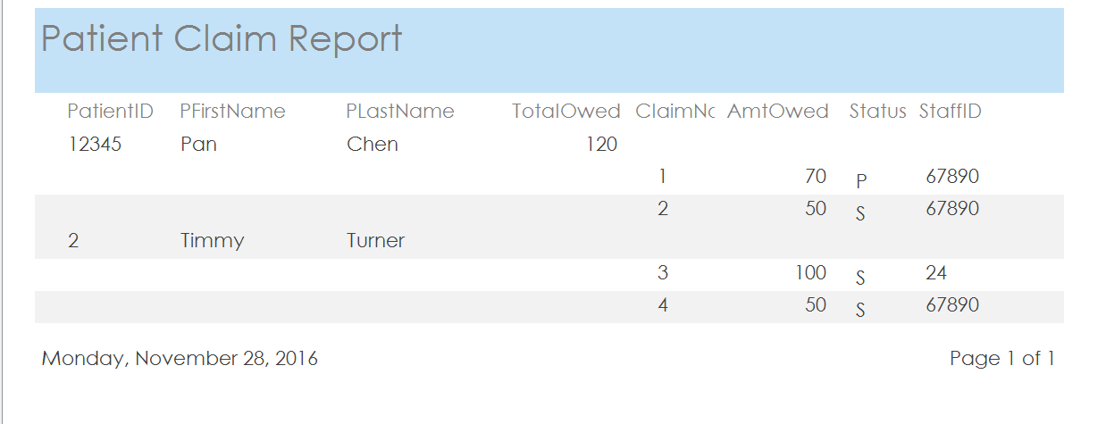
Report 1
How many claims are associated with each patient? What are they?

Slide 13
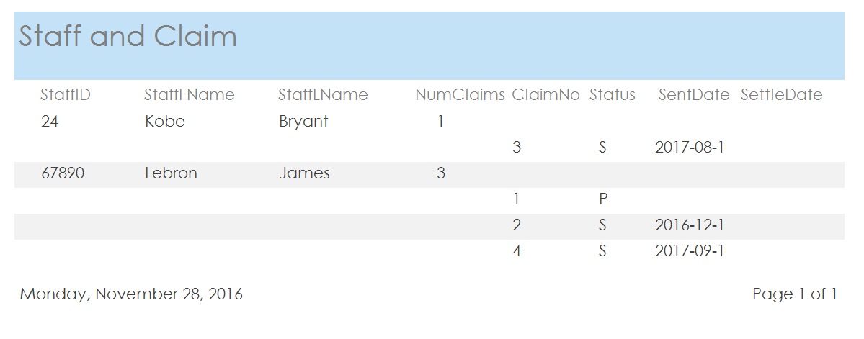
Report 2
What claims are handled by each staff member?

Slide 14
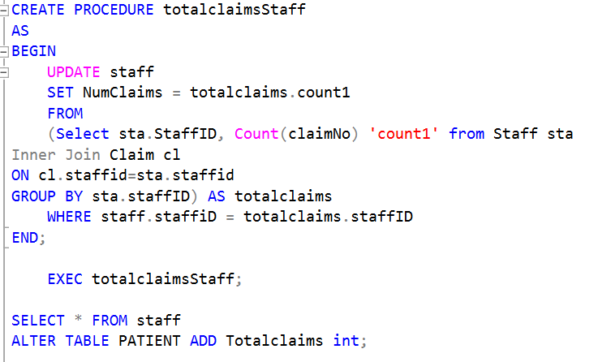
Procedure
This procedure count how many claims are handled by each staff

Slide 15
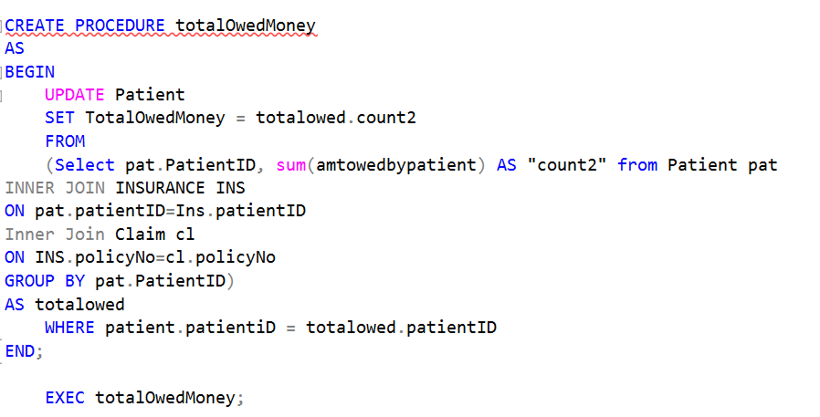
Procedure
This procedure count how much money does each patient owe

Slide 16
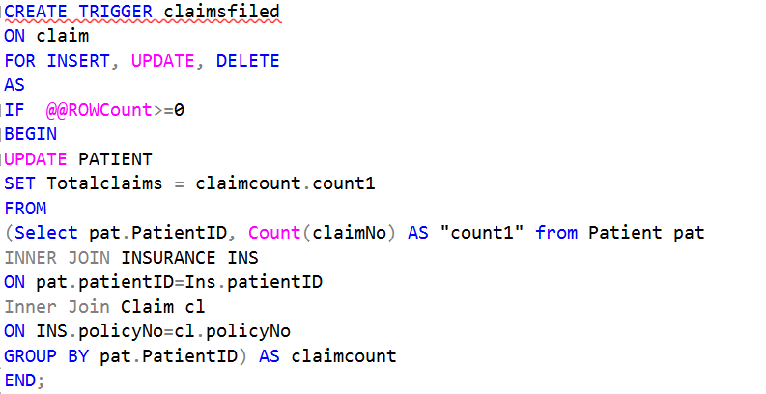
Trigger
This trigger updates the number of claims from patients when a new claim entry is created or deleted

Slide 17
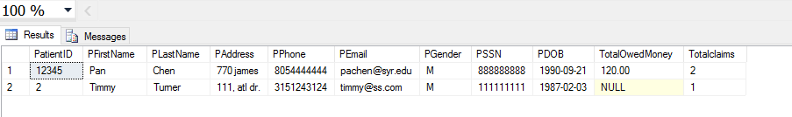
Trigger
Patient table with number of Claims before data is updated
SELECT * FROM Patient;

Slide 18
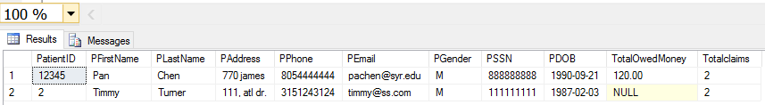
Trigger
Staff table with number of claim after another claim is filed for Timmy
INSERT INTO CLAIM (CLAIMNO, policyno,visitID,StatusID,StaffID,Claimdate,sentdate,AmtClaimed,AmtPaidByIns,AmtPaidByPatient)
values('4', '10002', '13', '125','67890','2017-09-10','2017-09-10',300,250,0);

